Slide 1
Big Data
Analytic Software Pod 6 Presentation
Jay Noppone P, Abdul Andha, Olu Kukoyi, Nur Mazumder, Mansij Mishra, Tajwar Rahman

Slide 2






The Team
Abdul Andha
Olu Kukoyi
Nur Mazumder
Jay Noppone P
Tajwar Rahman
Mansij Mishra

Slide 3
Agenda
01
02
03
04
05
06
Overview
History
Benchmarking
You can describe the topic of the section here
You can describe the topic of the section here
You can describe the topic of the section here
Relevance
Recommendation
QnA
You can describe the topic of the section here
You can describe the topic of the section here
You can describe the topic of the section here

Slide 4
01
Overview
You can enter a subtitle here if you need it

Slide 5
What are Big Data tools?
Big Data refers to vast amounts of structured and unstructured data, that are sourced from social media, IoT devices, and online interactions. These datasets are so huge and complex, that traditional data management systems struggle store, process, and analyse them efficiently.
For these reason, new Big Data Tools are emerging to help companies handle continuous data streams from various sources, making it possible to process data in real-time, monitor events as they happen, and quickly gain actionable insights. Some tools include Apache Kafka, Amazon Kinesis, Google Cloud Dataflow.

Slide 6
Advantages of Big Data Tools
Scalability
Real-time processing
These tools expand capacity by adding servers rather than upgrading hardware.
They dynamically adjust resources to handle varying data loads.
Tools like Kafka and Kinesis support global, distributed data processing.
Data is ingested and processed within seconds for time-sensitive applications.
These tools support real-time analytics, essential for fields like finance and healthcare.
They enable systems to react instantly to incoming data events.

Slide 7
Advantages of Big Data Tools
Efficiency
Community Support
Tools like Dataflow and Kinesis automatically optimize resource use, reducing costs.
High throughput capabilities reduce processing delays and prevent bottlenecks.
Built-in fault tolerance ensures data integrity and minimizes downtime.
Each tool integrates well with cloud and third-party services, with ample documentation.
Regular updates and support keep these tools aligned with the latest data needs and innovations.

Slide 8
02
History
You can enter a subtitle here if you need it

Slide 9
History of Kafka, Google Cloud, & AWS
Apache Kafka
AWS Kinesis
Google Cloud Dataflow
- Developed by LinkedIn engineers in 2011 for processing streaming data in real time
- Originally open-sourced but became a project under the Apache Software Foundation
- Designed to operate as a distributed commit log, offering high scalability and fault tolerance
- Introduced by Amazon in 2013 to meet the demand for real-time data streaming on AWS
- Initially launched as Kinesis Streams, later expanded to include: Kinesis Firehose, Kinesis Data Analytics, Kinesis Video Streams
- Became widely adopted for IoT, clickstream, and event-driven applications within the AWS ecosystem
- Launched by Google in 2015, built on Google’s internal tools like MapReduce, Flume, and MillWheel
- Based on the Apache Beam model, which unifies stream and batch processing under one API
- Influential in popularizing serverless, managed data processing solutions, especially for Google Cloud Platform users

Slide 10
03
Benchmarking
You can enter a subtitle here if you need it

Slide 11
Tabular Comparison
Criteria | Apache Kafka | AWS Kinesis | GCP Dataflow
Learning Curve | Steep | Moderate | Low to Moderate
Use Case | Real-time analytics, event streaming, ETL | Real-time data streaming and analytics | Real-time data processing, ETL
Flexibility | Open source | Managed by AWS | Managed by GCP
Pricing | Self-hosted infrastructure | Pay-as-you-go model based on usage | Pay-as-you-go model based on usage
Scalability | Highly scalable; distributed structure | Automatically scalable within AWS | Automatically Scalable within GCP

Slide 12
04
Industry & Academic Relevance

Slide 13


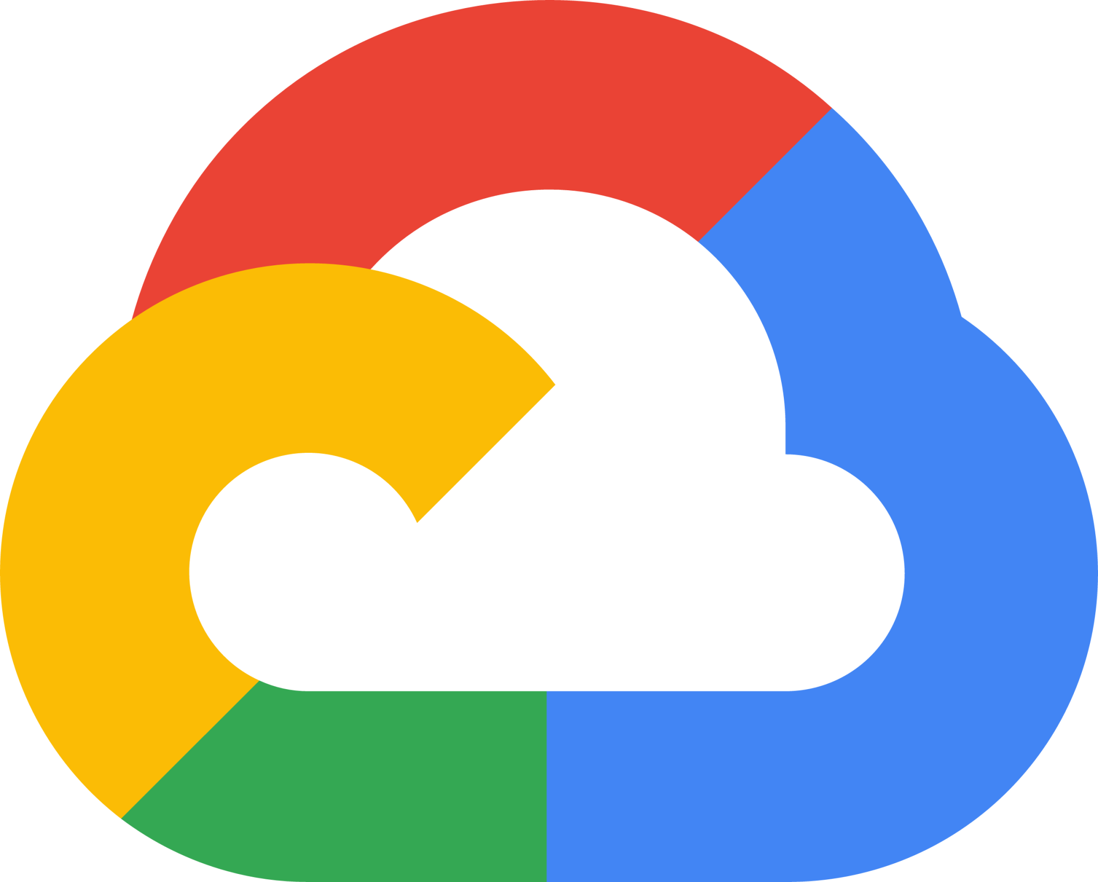
Large-scale real-time data processing
High-usage demand
High customer base
LinkedIn, Uber, Netflix, JP Morgan Chase, PayPal
Smaller end of large-scale companies
Requires real-time processing, but room for latency
Streaming & entertainment
Disney+, Comcast, Twitch
Large-scale companies
Less-intensive real-time processing
Benefits from Google’s ML and BigQuery products
Twitter, The New York Times, Spotify

Slide 14
05
Recommendation
You can enter a subtitle here if you need it

Slide 15
Recommendations
Google Cloud Dataflow
Auto-scaling
Cost Efficiency
Unified Processing
Automatically adjusts resources based on data volume, ensuring efficient performance for fluctuating workloads, such as monitoring real-time user behavior or transaction processing.
Serverless, pay-per-use model helps control costs, making it ideal for unpredictable workloads like event-driven analytics.
Combines both streaming and batch processing in one platform, ideal for use cases like real-time analytics and IoT sensor data, where both real-time and periodic batch analysis are needed.

Slide 16
QnA

Slide 17
Thank you!

